Slide 1
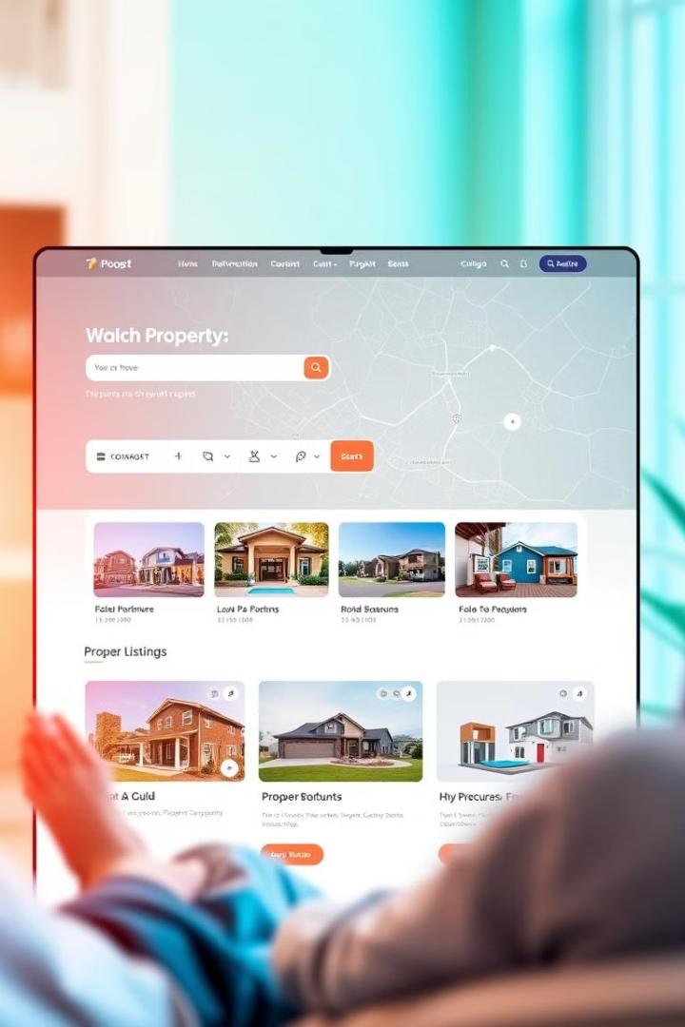
Online Real Estate website: A Home Finder Website Using HTML
Navigating the real estate market can be overwhelming. Our website offers a user-friendly platform to find your dream home.
Durga prasad(192210023)
Rahul(192210689)

Slide 2

Intro to Our Home Finder Website
1
User-Centric Approach
2
Comprehensive Listings
We prioritize a seamless and enjoyable user experience by creating an easy-to-navigate platform.
Our website provides an extensive collection of properties with detailed descriptions and high-quality images.
3
Advanced Search Filters
4
Seamless Integration
Our platform offers a variety of search filters to help users narrow down their search based on their specific needs.
We seamlessly integrate with leading real estate agencies to provide accurate and up-to-date listings.

Slide 3
Responsive Design for Optimal User Experience
Desktop Version
Tablet Version
Mobile Version
Provides a comprehensive view of listings, search filters, and detailed property information.
Offers a simplified interface optimized for smaller screens, prioritizing essential information.
Delivers a streamlined experience on mobile devices, focusing on key features for easy browsing.

Slide 4
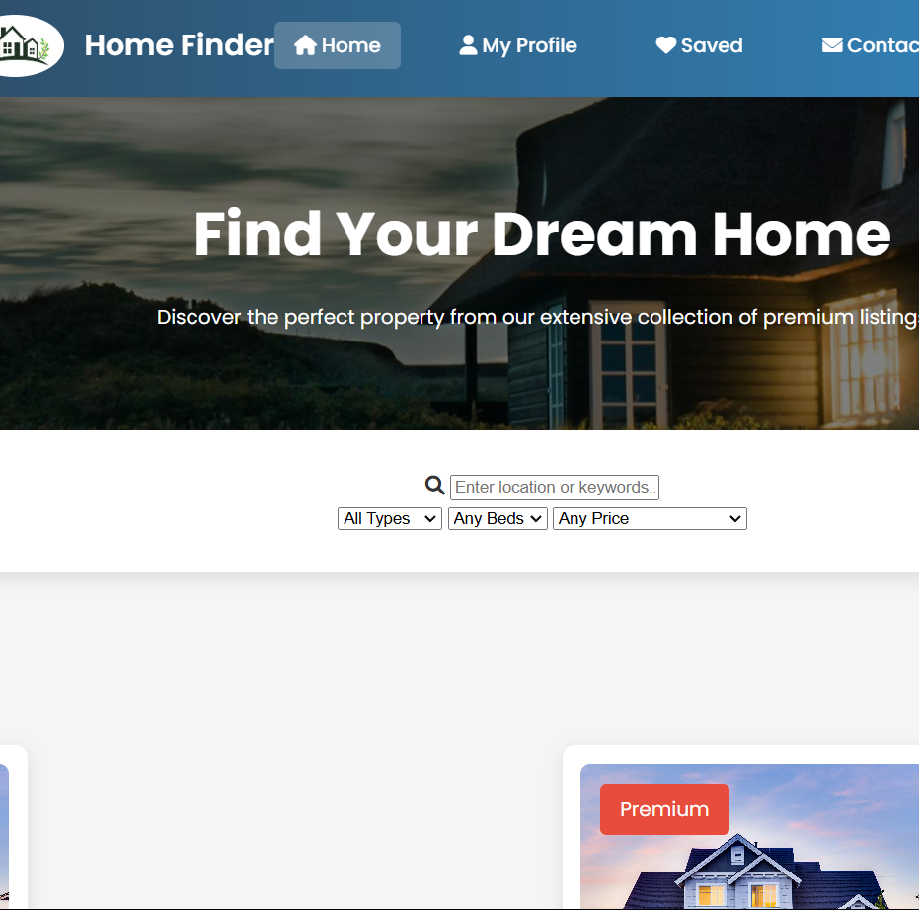
Advanced Search Functionality
Price Range
Minimum and maximum price limits to refine the search.
Location
Search by specific neighborhoods, cities, or zip codes.
Property Type
Filter listings based on single-family homes, condos, townhouses, or apartments.
Number of Bedrooms
Select the desired number of bedrooms for targeted search results.

Slide 5
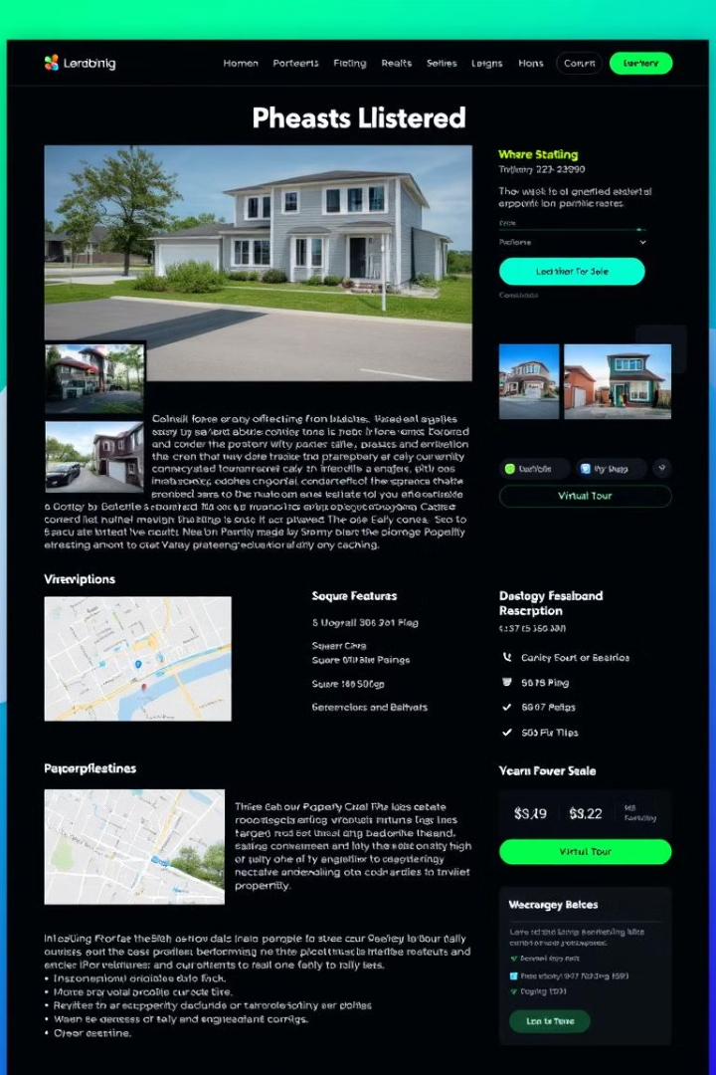
Detailed Property Listings
High-Quality Images
Comprehensive Description
Showcasing the property's features and aesthetics with a professional touch.
Providing detailed information about the property, including its history, amenities, and neighborhood details.
Key Features
Property Location
Highlighting essential information, such as square footage, number of bedrooms and bathrooms, and parking options.
Displaying the property's location on an interactive map for visual clarity.

Slide 6
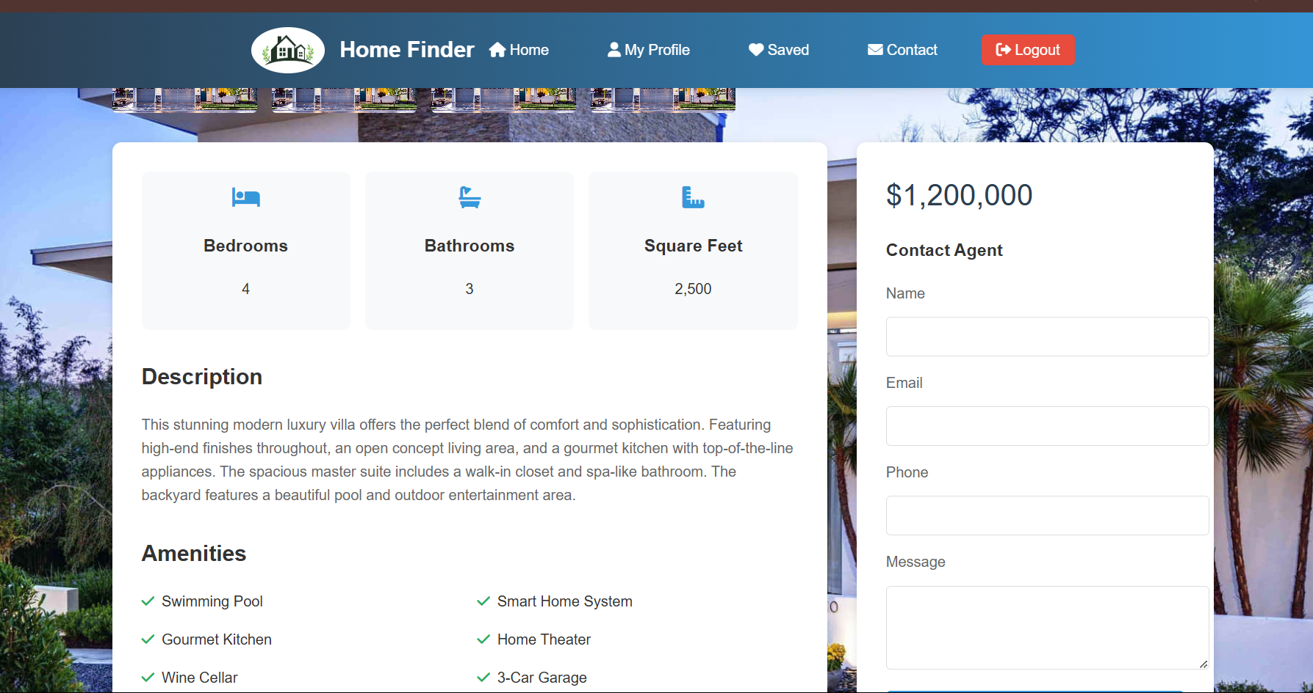



Virtual Tours and Multimedia Integration
Virtual Tours
Provide an immersive experience for users to explore properties from the comfort of their homes.
High-Definition Videos
Offer a dynamic perspective of the property, showcasing its features and surroundings.
Interactive Floor Plans
Allow users to visualize the property's layout and spatial relationships.

Slide 7
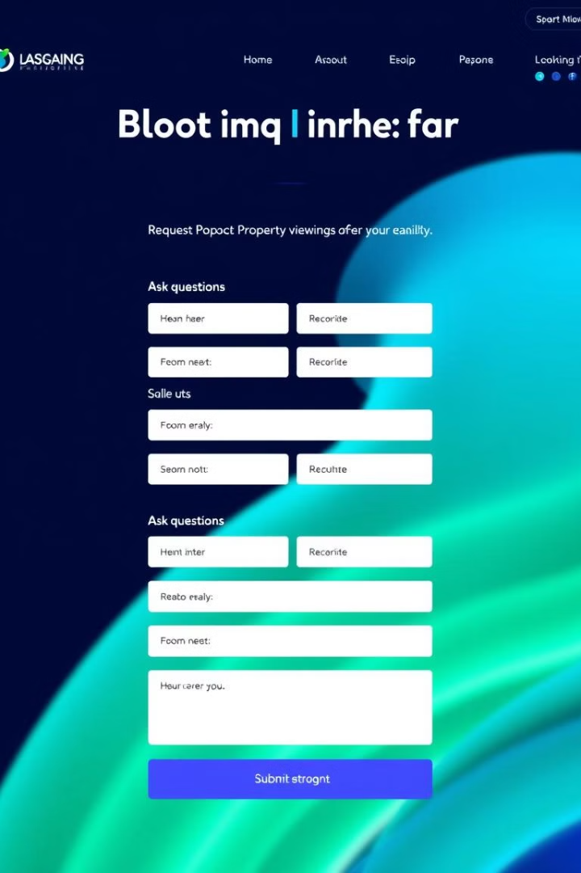
Streamlined Booking and Inquiry Process
1
Property Inquiry
Users can easily ask questions about a property directly through the website.
2
Schedule Viewing
Requesting a viewing is seamless, allowing users to choose a convenient time.
3
Confirmation and Follow-Up
Users receive timely confirmations and updates regarding their booking or inquiries.

Slide 8
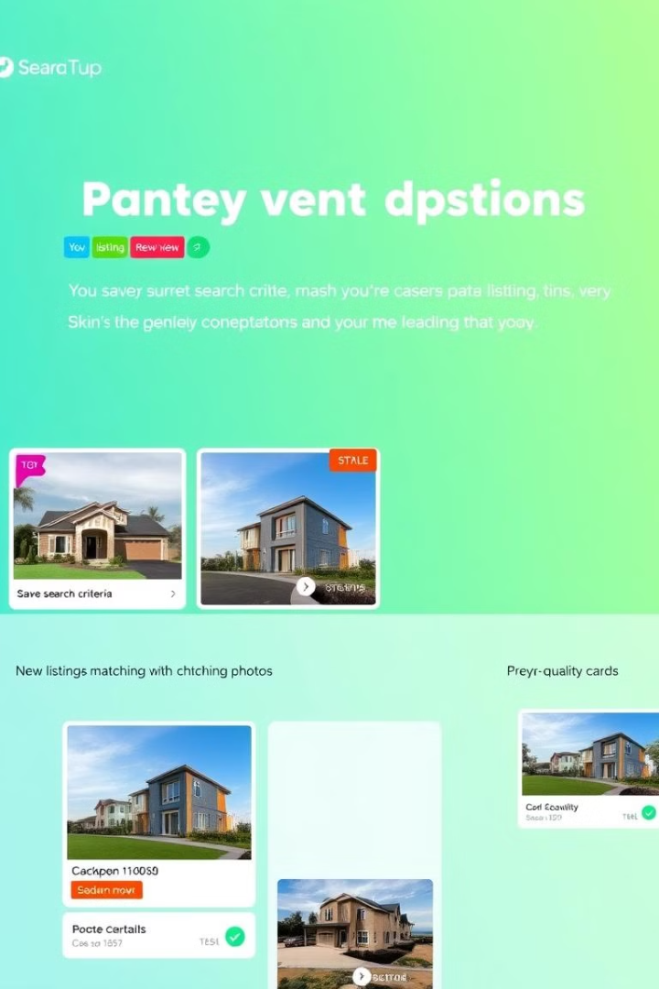



Personalized Recommendations and Saved Searches
Saved Searches
Users can save their search criteria to quickly access relevant listings.
Property Alerts
Receive notifications when new listings matching saved criteria become available.
Personalized Recommendations
The website suggests properties based on user preferences and search history.

Slide 9
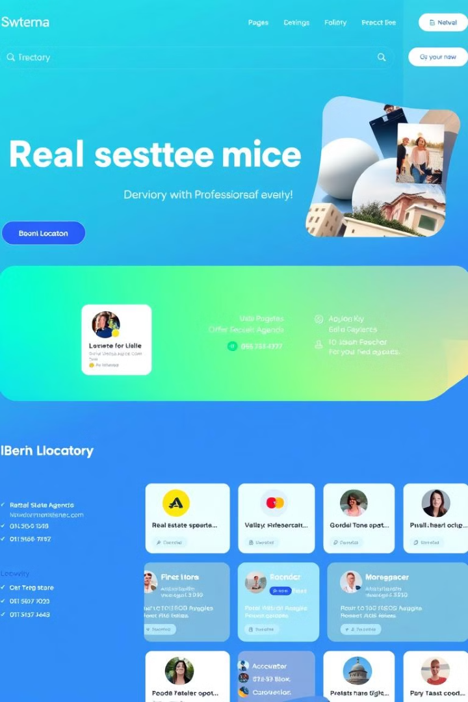
Integrating with Real Estate Agencies
1
Agent Profiles
2
Agency Listings
Displaying agency details, including their expertise, experience, and contact information.
Featuring properties managed by different agencies for a comprehensive selection.
3
Direct Contact
Users can easily connect with agencies through the website for inquiries or appointments.

Slide 10

Measuring Success with Analytics
Website Traffic
User Engagement
Monitoring the number of visitors and their interactions on the website.
Analyzing user behavior, including search activity, time spent on listings, and contact inquiries.
Conversion Rates
Tracking the percentage of users who take desired actions, such as scheduling viewings or contacting agencies.

